Slide 1
Chapter 19.
Fuzzy Reasoning
Comp3710 Artificial Intelligence
Computing Science
Thompson Rivers University

Slide 2

Course Outline
Part I – Introduction to Artificial Intelligence
Part II – Classical Artificial Intelligence
Part III – Machine Learning
  Introduction to Machine Learning
  Neural Networks
  Probabilistic Reasoning and Bayesian Belief Networks
  Artificial Life: Learning through Emergent Behavior
Part IV – Advanced Topics
  Genetic Algorithms
  Fuzzy Reasoning, Fuzzy Expert Systems, Fuzzy Control Systems
Fuzzy Logic

Slide 3
Chapter Objectives
Fuzzy systems
TRU-COMP3710
Rules and Expert Systems

Slide 4
Chapter Outline
Course outline
Introduction
Bivalent and Multivalent Logics
Linguistic Variables
Fuzzy Sets
Membership Functions
Fuzzy Set Operators
Hedges
Fuzzy Logic
Fuzzy Inference
Fuzzy Rules
Fuzzy Expert Systems
Fuzzy Control Systems – very important
Fuzzy Logic

Slide 5
Reference
Artificial Intelligence Illuminated, Ben Coppin, Jones and Bartlett Illuminated Series
Fuzzy logic; fuzzy set
http://en.wikipedia.org
Fuzzy logic tutorial
http://www.seattlerobotics.org/encoder/mar98/fuz/flindex.html
An introduction to fuzzy control system
http://www.faqs.org/docs/fuzzy/
Slides from other people
  Fuzzy logic/sets/controls/systems – Prof. Brouwer
  Industrial application of fuzzy logic control
  Fuzzy logic basics – Prof. Kecman
Fuzzy Logic

Slide 6
1. Introduction
In the previous unit of rule-based expert systems,
  [Q] Which part is difficult to implement?
  [Q] Have expert systems been successful?
[Wikipedia] The expert system has a major flaw which explains its low success although the principle has existed for 70 years: knowledge collection and interpretation into rules, the knowledge engineering.
  Most developers have no method to perform this task.
  They work manually what opens to many possibilities for errors.
[Q] How to handle uncertainty?
  E.g., IF name is “Bob” ∧ weather is cold THEN tell “Bob” ‘Wear a coat’
  “cold” is not a bivalent value.
Fuzzy Logic

Slide 7
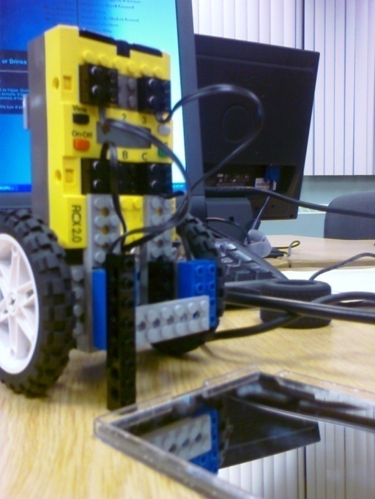
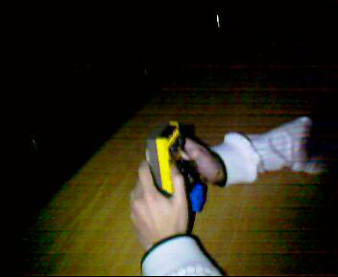
Topics
[Q] How to move the two wheel toy back and forth? This was one of the student projects some years ago.
[Q] Pendulum problem? http://www.youtube.com/watch?v=SVKKPD23eM4
https://www.youtube.com/watch?v=2qwgPbRYLcc
Fuzzy Logic

Slide 8
2. Bivalent and Multivalent Logics
Topics
Bivalent (Aristotelian) logic uses two logical values – ??? and ???.
Multivalent logics use many logical values – often in a range of real numbers from 0 to 1.
Important to note the difference between multivalent logic and probability
  P(A) = 0.5 means that A may be true or may be false
  A logical value of 0.5 means both true and false at the same time.
  The difference is still ambiguous to many scholars.
[Q] Do you think you can use probability theory for
  IF name is “Bob” ∧ weather is cold THEN tell “Bob” ‘Wear a coat’
  “cold” is not a bivalent value.
We will go back to “probabilistic reasoning” after this ‘fuzzy reasoning.”
Fuzzy Logic

Slide 9
3. Linguistic Variables
[Q] Do you dream in English, Chinese, Korean, French, or Mathematics?
[Q] Do you think or reason with numbers, images or symbols?
[Q] How do you express words, i.e., linguistic variables, in a computer system?
  IF name is “Bob” ∧ weather is cold THEN tell “Bob” ‘Wear a coat’
  “cold” is not a bivalent value.
Fuzzy Logic

Slide 10
Linguistic Variables
Topics
Bivalent logic does not fit to linguistic variables well, not like people.
Linguistic variables are used in fuzzy systems to express qualities such as height, which can take values such as “tall”, “short” or “very tall”.
These values define subsets of the universe of discourse, i.e., domain.
E.g., StrongFever
[Q] Then how to express ‘StrongFever’?
38.7°C
38.7°C
38°C
38°C
40.1°C
41.4°C
40.1°C
41.4°C
42°C
42°C
39.3°C
39.3°C
“Strong Fever”
“Strong Fever”
37.2°C
37.2°C
[Q] Is it okay?
[Q] What is the universe of discourse?
“More-or-Less” Rather Than “Either-Or” !

Slide 11
4. Fuzzy Sets
A classical crisp set is a set for which each value either is or is not contained in the set.
Example:
  A = A set of all the BCS students
  B = A set of the BCS students who are taking the AI class
  [Q] What is the universe of discourse for A?
  [Q] What is the universe of discourse for B?
[Q] Can a crisp set A be expressed as a function?
A classical crisp set is a set for which each value either is or is not contained in the set. In other words, all the values have 0 or 1.
M_{A} : X → {0,1},
where X is the universe of discourse, i.e., domain, for the crisp
set M_{A}. In the above example, X is the set of TRU students, and
only BCS students are mapped to 1.
Fuzzy Logic

Slide 12
Topics
For a fuzzy set, every value in the universe of discourse has a membership value, and so is a member to some extent.
The membership value defines the extent to which a variable is a member of a fuzzy set.
The membership value is from 0 to 1, inclusive.
[Q] Can a fuzzy set A be expressed as a function?
M_{A} : X → [0,1],
where X is the universe of discourse for the fuzzy set M_{A}.
Fuzzy Logic

Slide 13
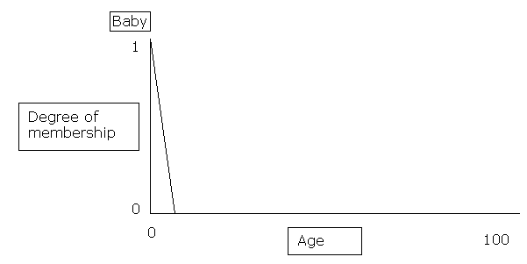

5. Membership Functions
The following function defines the extent to which a value x is a member of fuzzy set Baby:
E.g., this function would be stored in the computer as:
B = {(0, 1), (2, 0)}
This function could represent, for example, the extent to which a person can be considered a baby, based on their age.
The universe of discourse
Fuzzy Logic

Slide 14
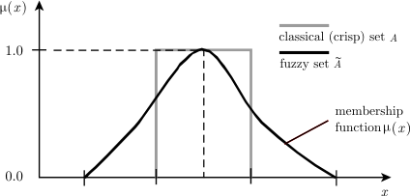
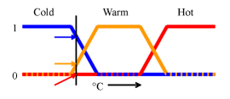
[Q] Is a crisp set a fuzzy set?
[Q] Is a fuzzy set a crisp set?
Fuzzy Logic

Slide 15

Another example of StrongFever
Discrete Definition for StrongFever:
µ_{SF}(35°C) = 0 µ_{SF}(38°C) = 0.1 µ_{SF}(41°C) = 0.9
µ_{SF}(36°C) = 0 µ_{SF}(39°C) = 0.35 µ_{SF}(42°C) = 1
µ_{SF}(37°C) = 0 µ_{SF}(40°C) = 0.65 µ_{SF}(43°C) = 1
Continuous Definition:
39 is 35% likely StrongFever.
© INFORM 1990-1998 Slide <number>
Notes:
Industrial Application of Fuzzy Logic Control -1-

Slide 16
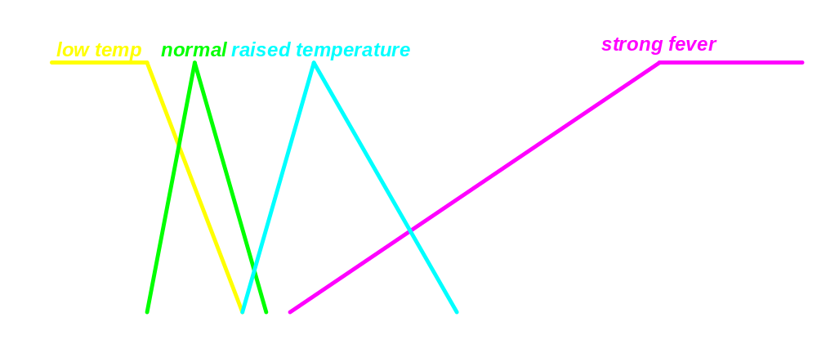
...Terms, Degree of Membership, Membership Function, Base Variable...
… pretty much raised …
A Linguistic Variable Defines a Concept of Our Everyday Language!
... but just slightly strong …
© INFORM 1990-1998 Slide <number>
Notes:
Industrial Application of Fuzzy Logic Control -1-

Slide 17
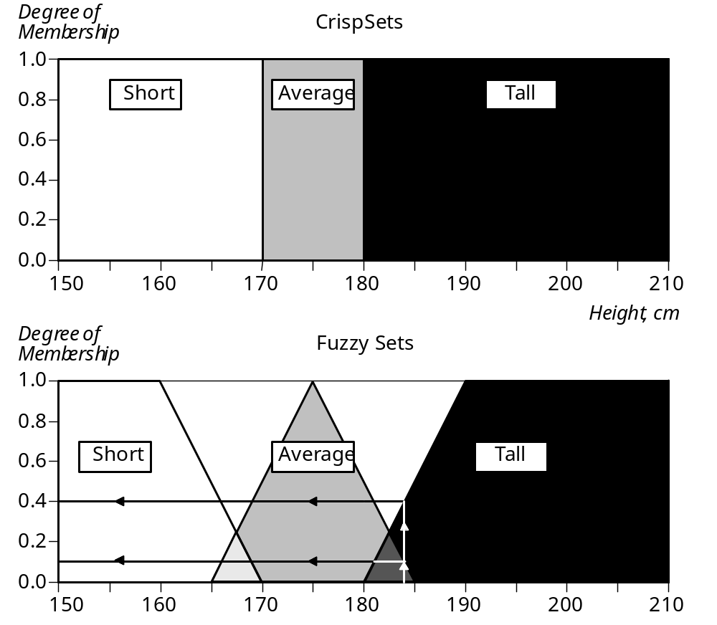
What do you say about 184cm?
Only ‘Tall’
0.1 much ‘Tall’ and
0.4 much ‘Average’
Notes:
Industrial Application of Fuzzy Logic Control -1-

Slide 18
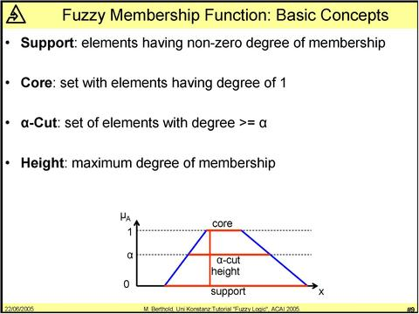
Membership Function: Basic Concepts
Support: elements having non-zero degree of membership
Core: set with elements having degree of 1
Α-cut: set of elements with degree ≥ α
Height: maximum degree of membership
Fuzzy Logic

Slide 19
Topics
[Q] Now we know that linguistic terms can be defined as fuzzy sets. How to use fuzzy sets? Like crisp sets? Union, intersection, and complement? How about implication for inference?
  IF name is “Bob” ∧ weather is cold THEN tell “Bob” ‘Wear a coat’
Fuzzy Logic

Slide 20
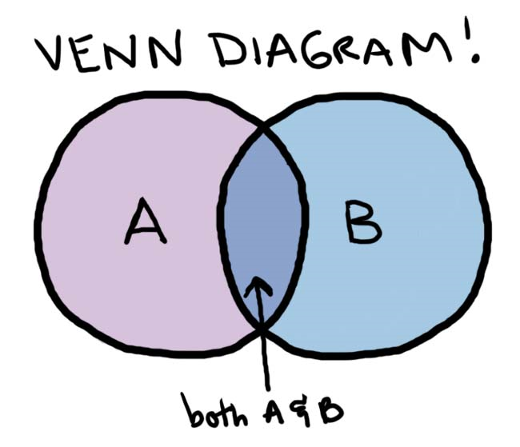
6. Fuzzy Set Operators
The three crisp set operators?
  ¬A – the complement of A, which contains the elements which are not contained in A.
  A ∩ B – the intersection of A and B, which contains those elements which are contained in both A and B.
  A ∪ B – the union of A and B which contains all the elements of A and all the elements of B.
Fuzzy sets use the same operators, but the operators have different meanings.
[Q] Can you use Venn diagrams for fuzzy sets?
Fuzzy Logic

Slide 21
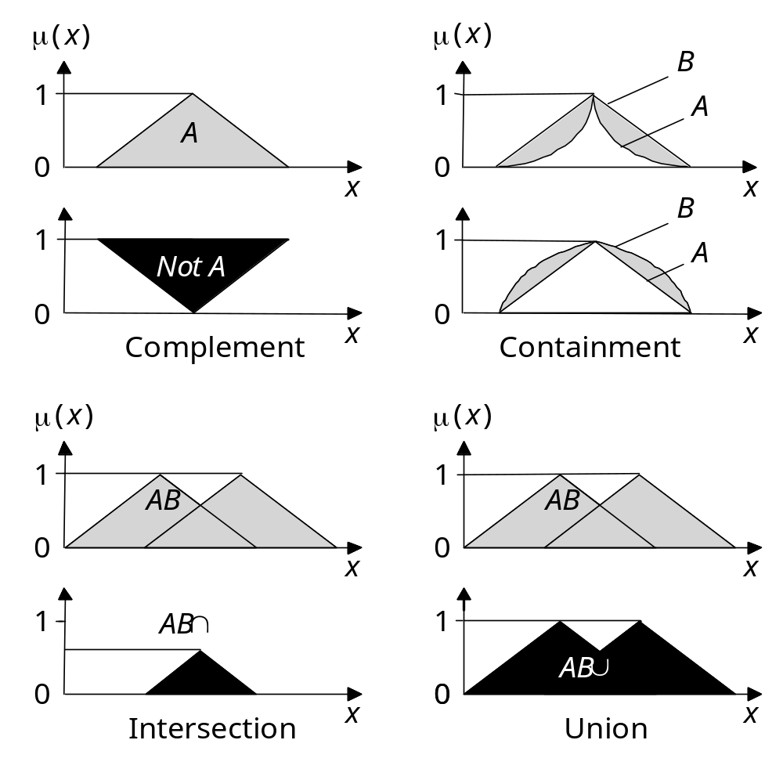
[Q] How to define?
A∩B
A∪B
Fuzzy Logic

Slide 22
Topics
Fuzzy set operators can be defined by their membership functions
  M_{¬A}(x) = ???
  1 – M_{A}(x)
  M_{A ∩ B}(x) = ???
  MIN (M_{A}(x), M_{B}(x)); there are many other different definitions.
  M_{A ∪ B}(x) = ???
  MAX (M_{A}(x), M_{B}(x)); there are many other different definitions.
We can also define containment (subset operator):
  B ⊂ A iff ∀x M_{B}(x) ≤ M_{A}(x)
Fuzzy Logic

Slide 23
7. Hedges
Topics
A hedge is a qualifier such as “very”, “quite”, “somewhat” or “extremely”.
When a hedge is applied to a fuzzy set it creates a new fuzzy set.
Mathematic functions are usually used to define the effect of a hedge.
For example, “very” might be defined as:
  M_{VA}(x) = (M_{A}(x))²
Fuzzy Logic

Slide 24
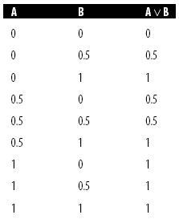
8. Fuzzy Logic
A non-monotonic logical system that applies to fuzzy variables.
We use connectives defined as:
  A ∨ B ≡ MAX (A, B)
  A ∧ B ≡ MIN (A, B)
  ¬A ≡ 1 – A
We can also define truth tables:
[Q] Can you make similar truth tables
for A ∧ B and ¬A?
[Q] How about implication operation?
  IF name is “Bob” ∧ weather is cold THEN tell “Bob” ‘Wear a coat’
Fuzzy Logic

Slide 25
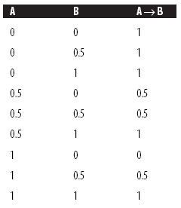
9. Fuzzy Inference
Fuzzy inference is harder to manage.
Since:
A → B ≡ ¬A ∨ B in bivalent logic
Hence, we might define fuzzy inference as:
A → B ≡ MAX ((1 – A), B)
This gives the unintuitive truth table shown on the right.
This gives us 0.5 → 0 = 0.5, where we would expect 0.5 → 0 = 0. (True → False?)
[Q] How to fix?
Fuzzy Logic

Slide 26
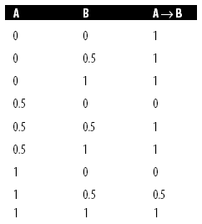
Topics
An alternative is Gödel implication, which is defined as:
A → B ≡ (A ≤ B) ∨ B , i.e.,
≡ 1 if A ≤ B, otherwise B
This gives a more intuitive truth table.
There are many other different definitions for conjunctions and disjunctions.
[Q] How do we use fuzzy disjunction, conjunction, negation, and implication?
Fuzzy Logic

Slide 27
10. Fuzzy Rules
A fuzzy rule takes the following form:
  IF <antecedent> THEN <consequent>
  E.g., IF A op x THEN B = y
  op: an operator such as >, < or =.
For example:
  IF temperature > 50 THEN fan speed = fast
  IF height = tall THEN trouser length = long
  IF study time = short THEN grades = poor
  IF study time = a lot THEN grades = great
Fuzzy Logic

Slide 28
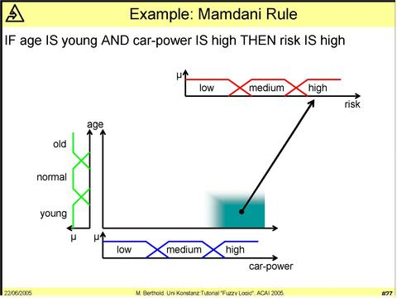
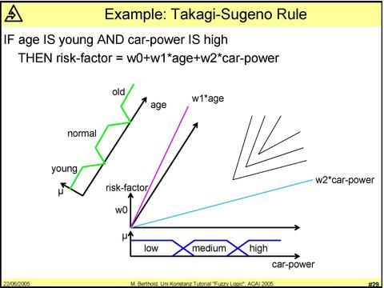
Topics
Fuzzy version 1: Mamdani rules
Fuzzy version 2: Takagi-Sugeno-Kang rules
Fuzzy Logic
Usually used for fuzzy control systems
Usually used for fuzzy expert systems

Slide 29
11. Fuzzy Expert Systems
Topics
A fuzzy expert system is built by creating a set of fuzzy rules, and applying fuzzy inference.
In many ways this is more appropriate than standard expert systems since expert knowledge is not usually black and white but has elements of grey.
The first stage in building a fuzzy expert system is choosing suitable linguistic variables.
Rules are then generated based on the expert’s knowledge, using the linguistic variables.
We won’t go through this topic much.
Fuzzy Logic

Slide 30
12. Fuzzy Control Systems
Mamdani inference derives a single crisp output value by applying fuzzy rules to a set of crisp input values. This can easily be used in control systems.
Step 1: Fuzzify the crisp inputs. [Q] No fuzzy inputs?
Step 2: Apply the fuzzified inputs to the antecedents of fuzzy rules to obtain a set of fuzzy outputs.
Step 3: Convert the fuzzy outputs to a single crisp value using defuzzification.
The above idea can be used in fuzzy control systems very well.
Fuzzy Logic

Slide 31
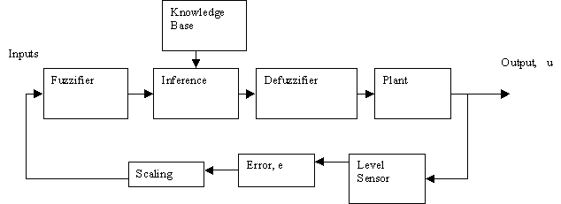
Typical Fuzzy Control System
Components:
Feedback information
Fuzzy Logic

Slide 32
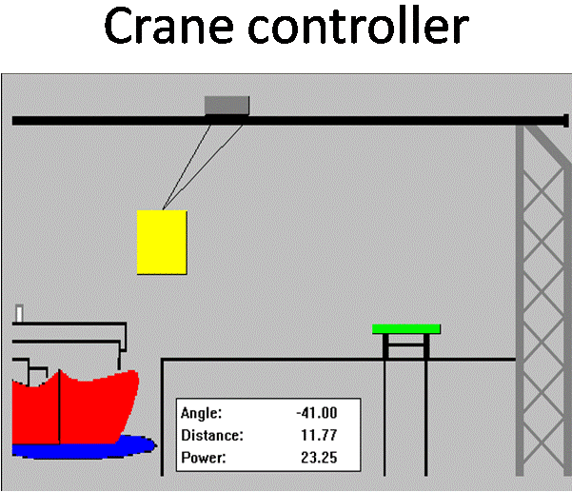
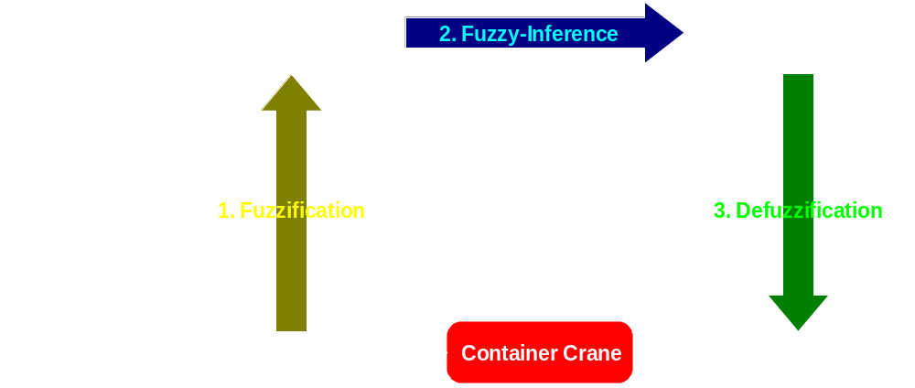
Example
Control Loop of the Fuzzy Logic Controlled Container Crane:
(Linguistic Values)
Fuzzy Logic

Slide 33
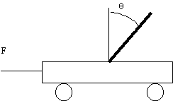

The Inverted Pendulum
Software that simulates a fuzzy expert controller maintaining an inverted pendulum in the vertical position, despite external disturbances. http://www.youtube.com/watch?v=SVKKPD23eM4
Positive
Negative
Electric current
Negative
Positive
Fuzzy Logic

Slide 34
Inverted Pendulum – fuzzy controller
balances a stationary inverted pendulum with variable mass, period, and motor strength.
[Q] Inputs ?
  angle away from vertical (Theta), with domain [-90, 90]
  change in angle (dTheta), with domain [-20, 20] – This feedback input is very important in every fuzzy control system.
[Q] Output ?
  Electric current that drives the motor. The domain is [-2, 2] for example.
Fuzzy Logic

Slide 35
Inverted Pendulum – fuzzy sets
[Q] Fuzzy values for all three variables, Theta, dTheta, and electric Current?
  Negative Medium (NM)
  Negative Small (NS)
  Zero (ZE)
  Positive Small (PS)
  Positive Medium (PM)
  Domain for Theta: [-90, 90]
  Domain for dTheta: [-20, 20]
  Domain for Current: [-2, 2]
[Q] How to define the above fuzzy sets, i.e., membership functions?
Fuzzy Logic

Slide 36
Theta
  Negative Medium (NM) [Q] Can -34 be considered as NM?
  [Q] Can -60 be considered as NM? How much?
1
0
-90
-45
0
45
90
Fuzzy Logic

Slide 37
Theta
  Negative Small (NS) [Q] Can -34 be considered as NS?
  [Q] Can -60 be considered as NS? How much?
1
0
-90
-45
0
45
90
Fuzzy Logic

Slide 38
Theta
  Zero (ZE) [Q] Can -34 be considered as ZE?
  [Q] Can -60 be considered as ZE? How much?
1
0
-90
-45
0
45
90
Fuzzy Logic

Slide 39
Theta
  Positive Small (PS)
1
0
-90
-45
0
45
90
Fuzzy Logic

Slide 40
Theta
  Positive Medium (PM)
1
0
-90
-45
0
45
90
Fuzzy Logic

Slide 41
Theta
  Negative Small (NM)
  Negative Small (NS)
  Zero (ZE)
  Positive Small (PS)
  Positive Medium (PM)
Similarly you can define fuzzy sets
for dTheta and Current.
NM
NS
ZE
PS
PM
1
0
-90
-45
0
45
90
Fuzzy Logic

Slide 42
Inverted Pendulum – fuzzy rules
If Theta is NM and dTheta is ZE then
Current is PM
If Theta is NS and dTheta is ZE then
Current is PS
If Theta is NS and dTheta is PS then
Current is ZE
If Theta is PS and dTheta is NS then Current is ZE
If Theta is PS and dTheta is ZE then Current is NS
If Theta is PM and dTheta is ZE then Current is NM
If Theta is ZE and dTheta is NM then Current is PM
If Theta is ZE and dTheta is NS then Current is PS
If Theta is ZE and dTheta is ZE then Current is ZE
If Theta is ZE and dTheta is PS then Current is NS
If Theta is ZE and dTheta is PM then Current is NM
Positive
Negative
Negative
Positive
???
Fuzzy Logic

Slide 43
Inverted Pendulum - fuzzy rules in matrix form
 | Theta
dTheta |  | NM | NS | ZE | PS
 | NM |  |  | PM
 | NS |  |  | PS | ZE
 | ZE | PM | PS | ZE | NS
 | PS |  | ZE | NS
 | PM |  |  | NM
Fuzzy Logic

Slide 44
Inverted Pendulum – fuzzy rules
Each fuzzy control rule relates input fuzzy sets to an output fuzzy set.
Each antecedent in the premise is a fuzzy association which admits a "level of validity"
Fuzzy "membership functions" defined for each variable determine the degree to which a "crisp," or numerical, input value belongs to each of five fuzzy-set values:
Fuzzy Logic

Slide 45
Inverted Pendulum – fuzzy sets
For all three variables
  Negative Medium (NM)
  Negative Small (NS)
  Zero (ZE)
  Positive Small (PS)
  Positive Medium (PM)
NM
NS
ZE
PS
PM
Crisp value
Fuzzy Logic

Slide 46
Inverted Pendulum – fuzzification
Input
fuzzified to two fuzzy sets
Theta
dTheta
Positive
Negative
NS, ZE
How much?
Negative
Positive
NM
NS
ZE
PS
PM
Input
ZE, PS
NM
NS
ZE
PS
PM
???
Fuzzy Logic

Slide 47
Theta
  Input: -11.25
  [Q] How to fuzzify -11.25?
  [Q] Which fuzzy set has non-zero membership value at -11.25?
Input
NM
NS
ZE
PS
PM
1
0
-11.25
-90
-45
0
45
90
Fuzzy Logic

Slide 48
Theta
  Input: -11.25
  [Q] How to fuzzify -11.25?
  Only NS and ZE have non-zero membership values at -11.25.
Input
NS
ZE
1
0
-11.25
-90
-45
0
45
90
Fuzzy Logic

Slide 49
Theta
  Input: -11.25
  [Q] How to fuzzify -11.25?
  Only NS and ZE have non-zero membership values at -11.25.
  -11.25 is fuzzified to NS with .25.
Input
NS
ZE
1
.25
0
-11.25
-90
-45
0
45
90
Fuzzy Logic

Slide 50
Theta
  Input: -11.25
  [Q] How to fuzzify -11.25?
  Only NS and ZE have non-zero membership values at -11.25.
  -11.25 is fuzzified to NS with .25.
  -11.25 is also fuzzified to ZE with .75.
  We have now two input fuzzy sets – NS with .25 and ZE with .75.
Similarly you can fuzzify dTheta input.
NS
ZE
1
.75
.25
0
-11.25
-90
-45
0
45
90
Fuzzy Logic

Slide 51
Input
fuzzified to two fuzzy sets
Theta
dTheta
Positive
Negative
NS (.25), ZE (.75)
Negative
Positive
NM
NS
ZE
PS
PM
Input
ZE (.6), PS (.3)
NM
NS
ZE
PS
PM
???
Fuzzy Logic

Slide 52
Inverted Pendulum – inference
 | Input: Theta
Input: dTheta |  | NM | NS | ZE | PS
 | NM |  |  | PM
 | NS |  |  | PS | ZE
 | ZE | PM | PS | ZE | NS
 | PS |  | ZE | NS
 | PM |  |  | NM
Fuzzy rules
Fuzzified input
There are four fuzzy sets representing two crisp inputs.
[Q] How many rules can be used?
Fuzzy Logic

Slide 53
Inverted Pendulum – inference
Theta:NS (.25) + dTheta:ZE (.6) -> Current:PS (???)
Theta:NS (.25) + dTheta:PS (.3) -> Current:ZE (???)
Theta:ZE (.75) + dTheta:ZE (.6) -> Current:ZE (???)
Theta:ZE (.75) + dTheta:PS (.3) -> Current:NS (???)
AND; OR
  M_{A ∩ B} (x) = MIN (M_{A} (x), M_{B} (x))
  M_{A ∪ B} (x) = MAX (M_{A} (x), M_{B} (x))
Fuzzy Logic

Slide 54
Inverted Pendulum – inference
Theta:NS (.25) + dTheta:ZE (.6) -> Current:PS (.25)
Theta:NS (.25) + dTheta:PS (.3) -> Current:ZE (.25)
Theta:ZE (.75) + dTheta:ZE (.6) -> Current:ZE (.6)
Theta:ZE (.75) + dTheta:PS (.3) -> Current:NS (.3)
AND; OR
Output fuzzy sets
  M_{A ∩ B} (x) = MIN (M_{A} (x), M_{B} (x))
  M_{A ∪ B} (x) = MAX (M_{A} (x), M_{B} (x))
0.6
[Q] Now, how to defuzzify?
0.3
0.25
NM
NS
ZE
PS
PM
Fuzzy Logic

Slide 55


Inverted Pendulum – defuzzification
Output fuzzy sets
  Current:PS (.25)
  Current:ZE (.6)
  Current:NS (.3)
[Q] How to defuzzify?
Some ideas for defuzzification
  Centroid – the center of the area
  Bisector - the vertical line that will divide the region into two sub-regions of equal area
  Middle, smallest and largest of maximum
Fuzzy Logic

Slide 56
Inverted Pendulum – defuzzification
Output fuzzy sets
  Current:PS (.25)
  Current:ZE (.6)
  Current:NS (.3)
1
0
-2
NM
-1
NS
0
ZE
1
PS
2
PM
[Q] Crisp output using Centroid ???
???
Fuzzy Logic

Slide 57
Inverted Pendulum – defuzzification
Centroid = ∑(C_{i}*A_{i}) / ∑A_{i}
In the below example,
  Area of NS with .3 = 2*.3 - .3*.3 = .51 Center of NS = -1
  Area of ZE with .6 = 2*.6 - .6*.6 = .84 Center of ZE = 0
  Area of PS with .25 = 2*.25 - .25*.25 = .4375 Center of PS = 1
  Centroid = (.51 * -1 + .84 * 0 + .4375 * 1) / (.51 + .84 + .4375) = -.040559441
1
0
-2
NM
-1
NS
0
ZE
1
PS
2
PM
Output using Centroid
???
Fuzzy Logic

Slide 58
Inverted Pendulum –
And then?
  Apply the power to the motor for a certain period of time
  Measure Theta and dTheta
  Do the previous process
Fuzzy Logic

Slide 59
Fuzzy Logic Controlled Air Conditioner
Topics
is coming soon!
Fuzzy Logic

